Slide 1
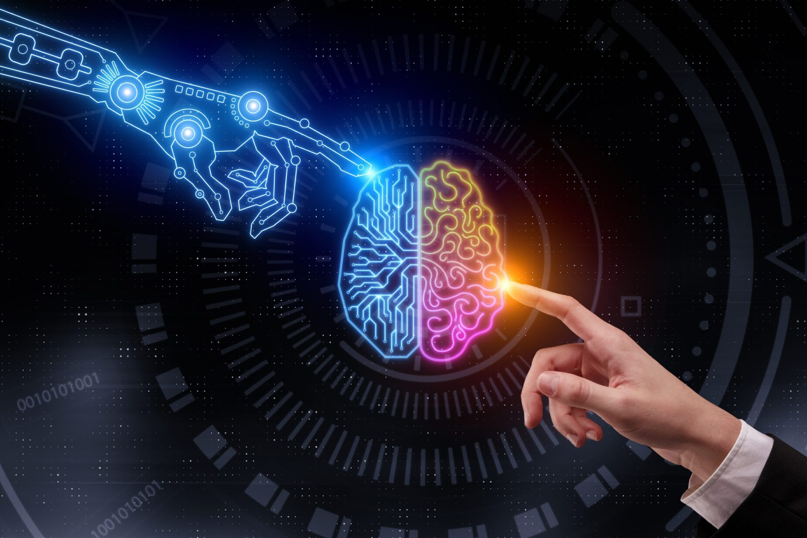
Emotion Dectection and Plant Disease Detection Using Convolutional Neural Networks (CNNs)

Slide 2


Problem Statement
The "Comprehensive Image Classification System Project" aims to develop an advanced Streamlit application to enhance various user experiences by providing accurate predictions. This project involves building two models: one for detecting and classifying emotions in human faces and another for identifying plant diseases from leaf images. Leveraging datasets and utilizing Convolutional Neural Networks (CNNs), the project integrates machine learning, computer vision, and user interface design. The project scope includes data processing, cleaning, feature engineering, model training, and deploying the models in a user-friendly application. By enabling users to upload images and receive accurate predictions, the application addresses applications in healthcare, education, customer service, and agriculture.

Slide 3


approach
Data Preprocessing
Ensure Data Quality
Building Models
Models for emotion detection and plant disease identification
Streamlit
Build an interactive Streamlit app

Slide 4


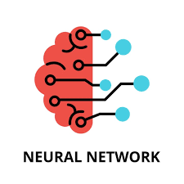

Technologies Used
Python
Cnn
Streamlit
"Python is essential in data cleaning, preprocessing, and Exploratory Data Analysis (EDA) due to its powerful libraries like Pandas, NumPy, Matplotlib, and Seaborn. These tools streamline handling large datasets, uncovering patterns, and providing deep insights. Additionally, it supports Machine Learning with libraries like Scikit-learn and TensorFlow."
CNNs are deep learning models specialized for image processing and pattern recognition. They use convolutional layers to extract features automatically, making them effective for tasks like image classification and object detection. Popular architectures such as ResNet and VGG enhance accuracy and efficiency in computer vision applications.
Streamlit is an open-source Python framework for creating interactive web apps with minimal code, ideal for data science and machine learning projects. It integrates easily with libraries like Pandas and Matplotlib, offering fast deployment and real-time interactivity.

Slide 5
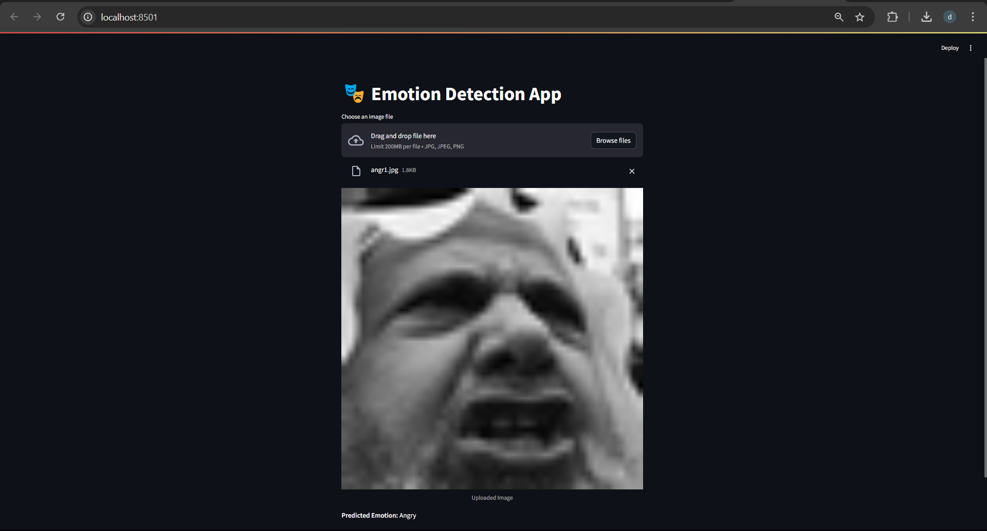

Slide 6
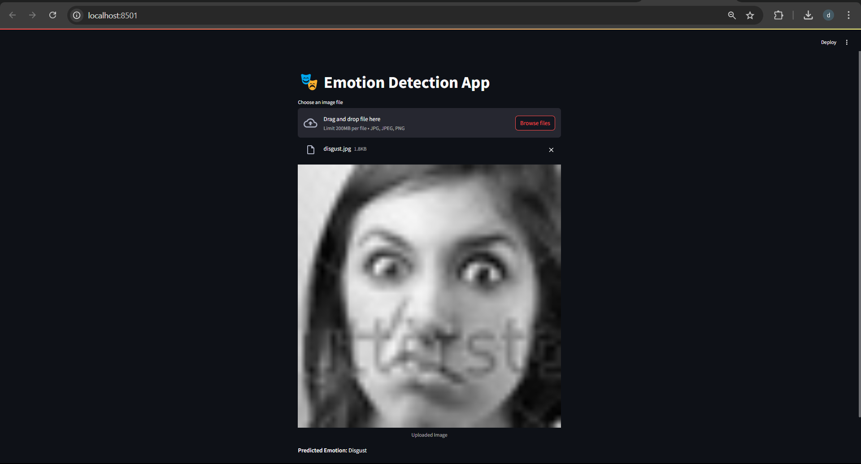

Slide 7
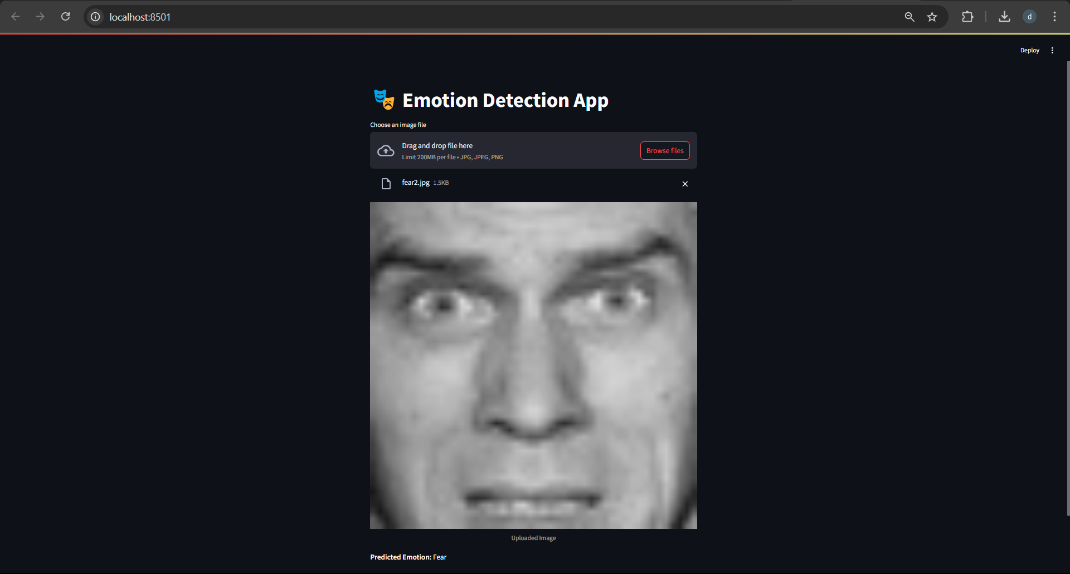

Slide 8
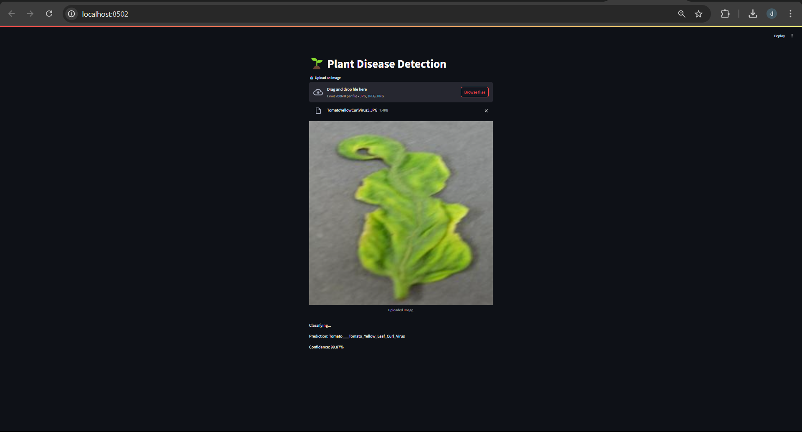

Slide 9
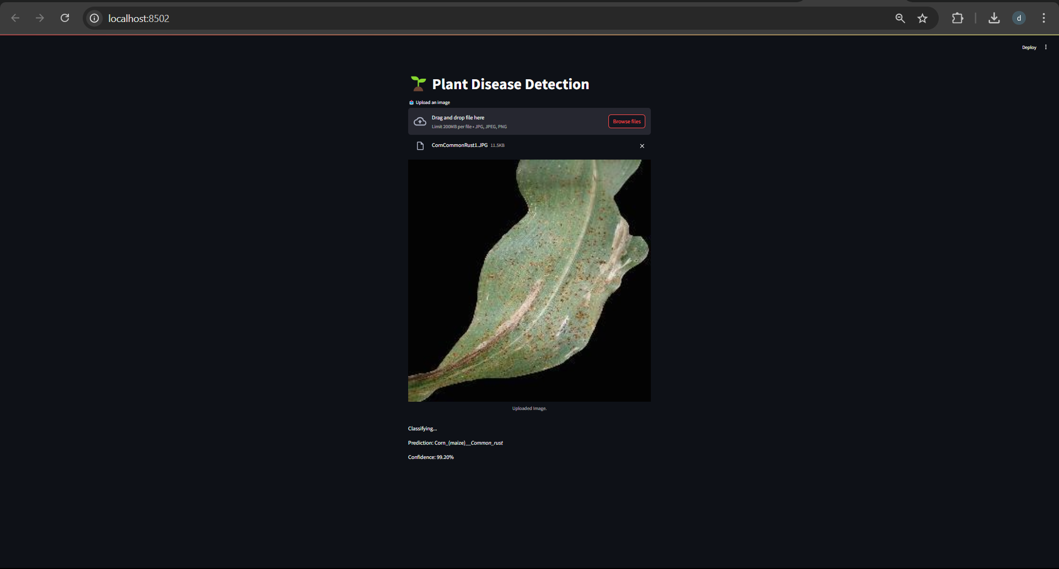

Slide 10
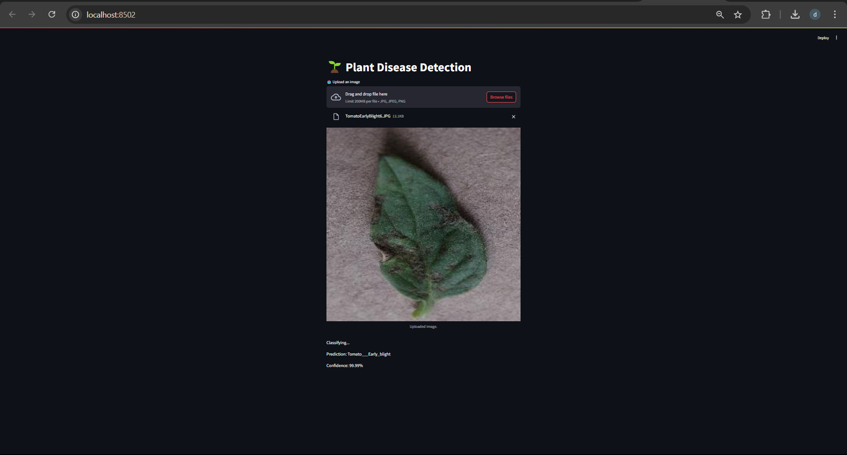

Slide 11


Thank You
Every end is a new beginning.

